Slide 1


Slide 2

CONTENT
GENERAL GUIDELINES
STUDENTS
PBL
RESEARCH AND RANKING
BUSINESS COLLABORATION
STRATEGY 2016-21

Slide 3

Introduction, change random picture

Slide 4

AAU – KNOWLEDGE FOR THE WORLD
All degree programmes and research activities at Aalborg University are problem and project-based and have an interdisciplinary focus.
Through strong interplay between staff and students and intense collaboration with public and private sectors, we offer degree programmes with a real-world approach and provide world-class research.
This results in new insights, new solutions to societal challenges and knowledge that changes the world.

Slide 5
AAU – KNOWLEDGE FOR THE WORLD
All degree programmes and research activities at Aalborg University are problem and project-based and have an interdisciplinary focus.
Through strong interplay between staff and students and intense collaboration with public and private sectors, we offer degree programmes with a real-world approach and provide world-class research.
This results in new insights, new solutions to societal challenges and knowledge that changes the world.

Slide 6
Time Management Table
Name | Time holding breath under water | Time without criticizing work | Time used for eating
Nicolai | 29:10 | 29:10 | 20:00
Thassilo | 10:02 | 10:02 | 20:00
Aitor | 00:17 | 00:17 | 20:00
Nicolas | 19:57 | 00:00 | ∞

Slide 7
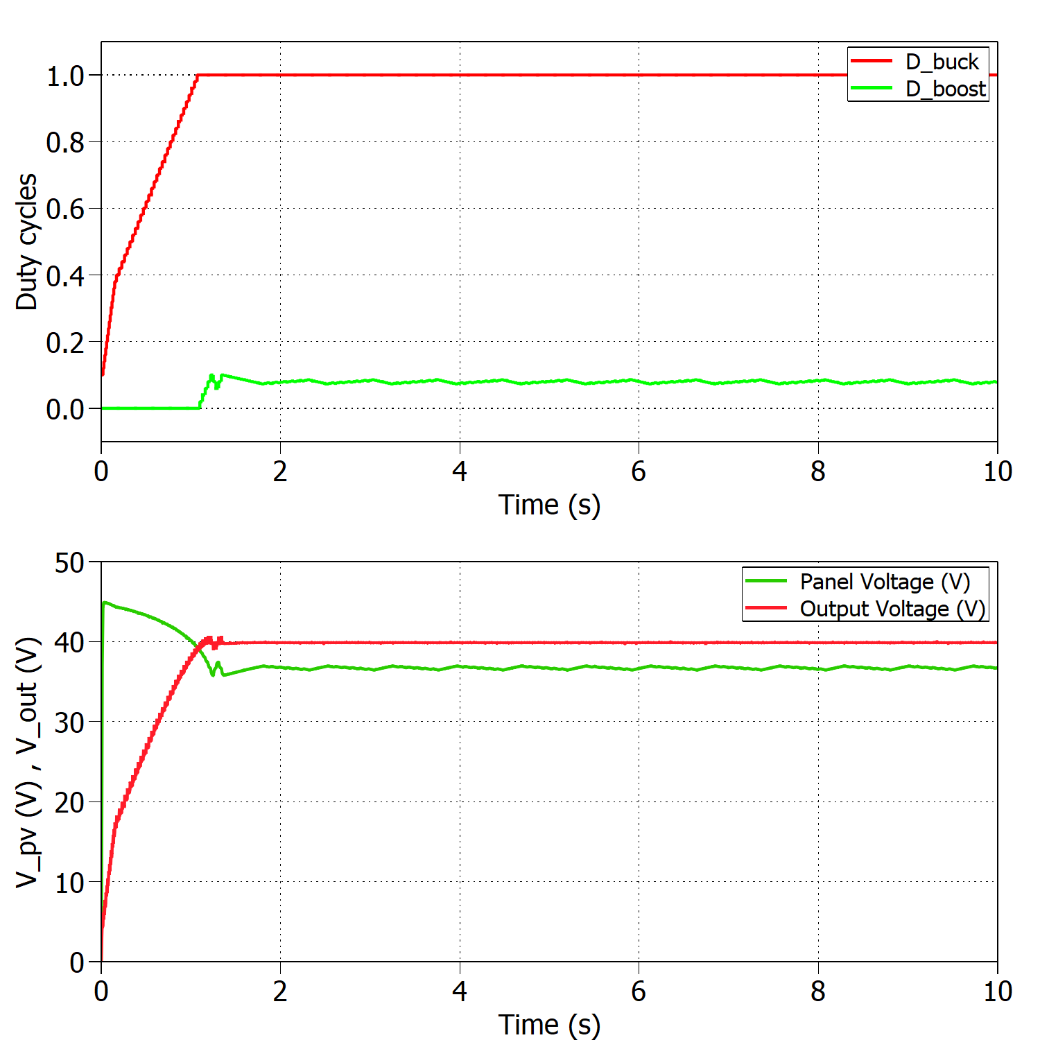
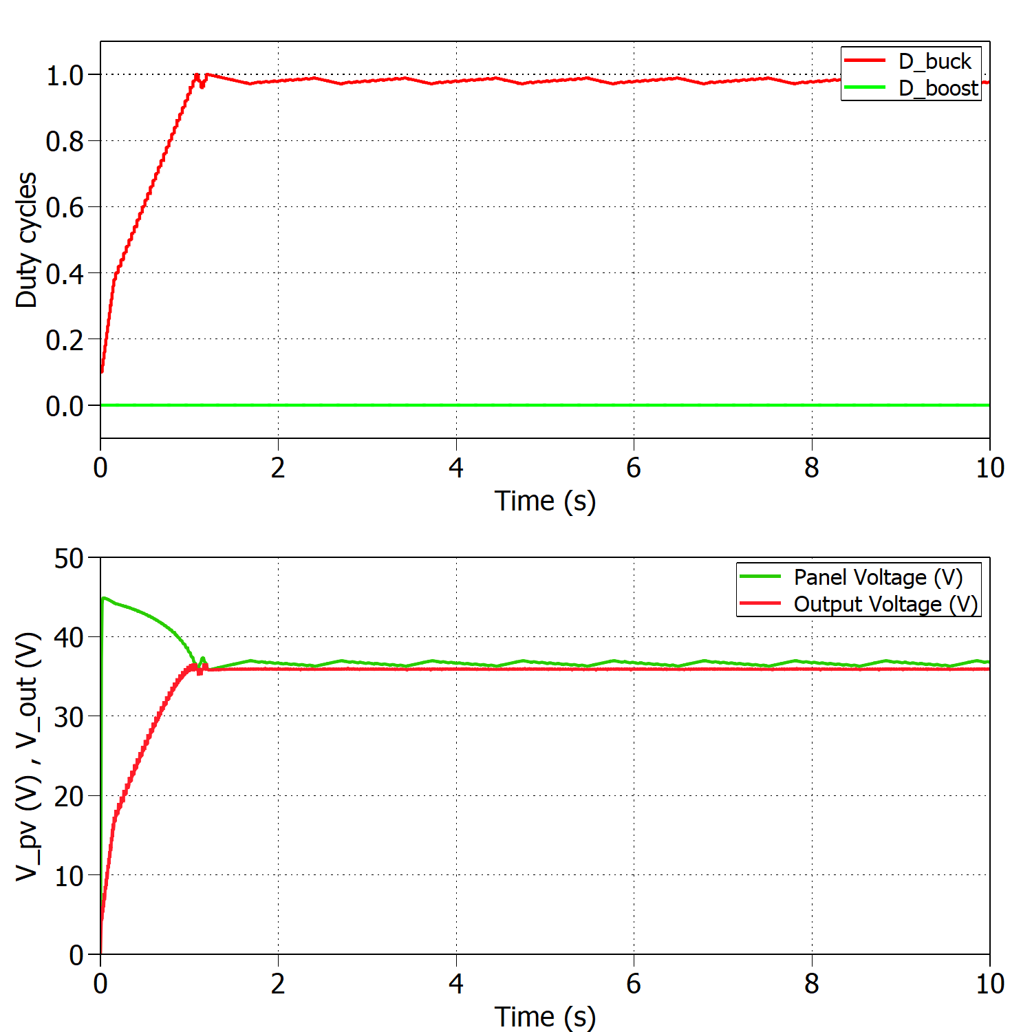
Time Management Table
Add a nice looking caption if you have multiple figures at one slide
And make sure that they are better aligned than this…

Slide 8
MPPT algorithm

Slide 9
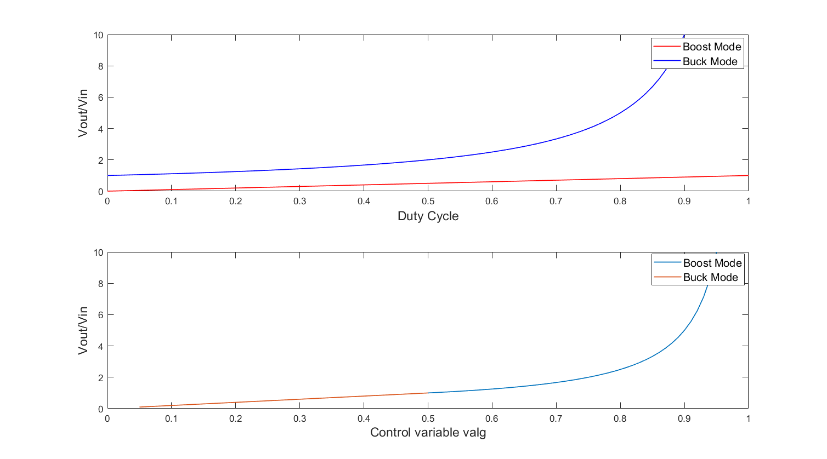

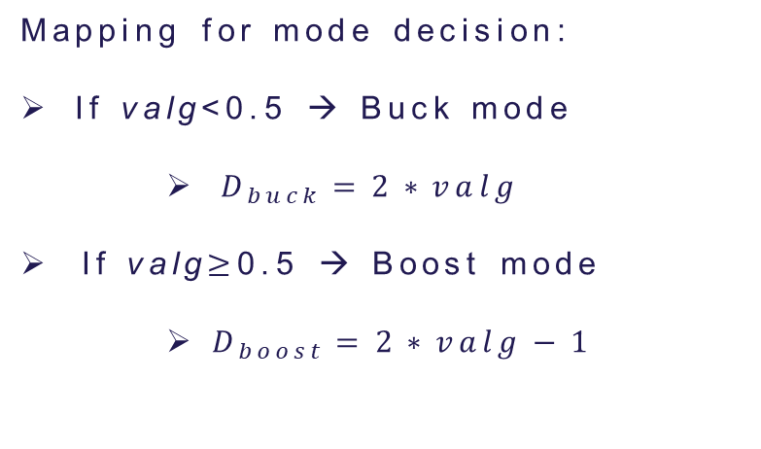
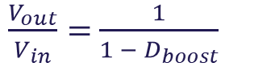
Initial MPPT implementation
$$\frac{V_{out}}{V_{in}}=D_{buck}$$
$\frac{V_{out}}{V_{in}}=$ $\frac{1}{1 − D_{boost}}$
Mapping for mode decision:
If valg<0.5 → Buck mode
$D_{buck}=2∗valg$
If valg$≥$0.5 → Boost mode
$D_{boost}=2∗valg−1$
Top figure: Conversion ratio for buck and boost modes.
Bottom figure: Mapping of the control variable valg for mode decision.
Incrementing valg means decreasing PV voltage!

Slide 10
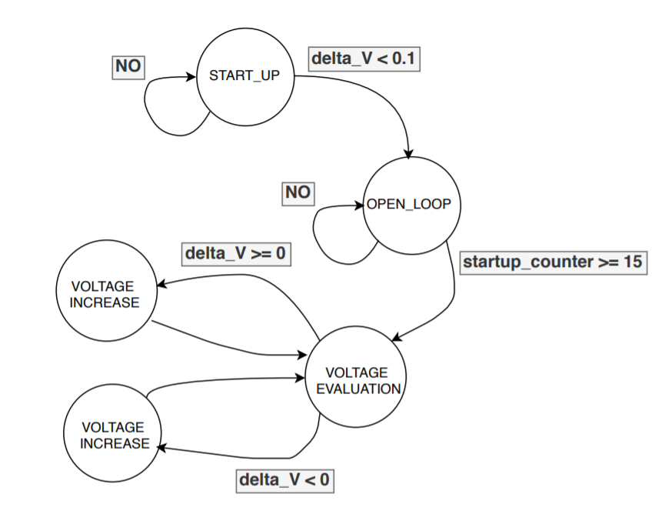
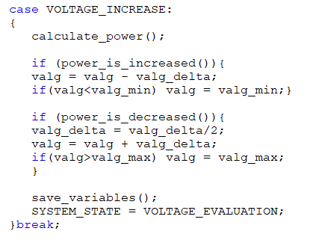
Initial MPPT implementation
When crossing the MPP the control variable is reduced to half of its value iteratively!
Problems:
“If/else” structure difficult to find errors
Variable step required more complex code
Finite state machine for P&O algorithm

Slide 11
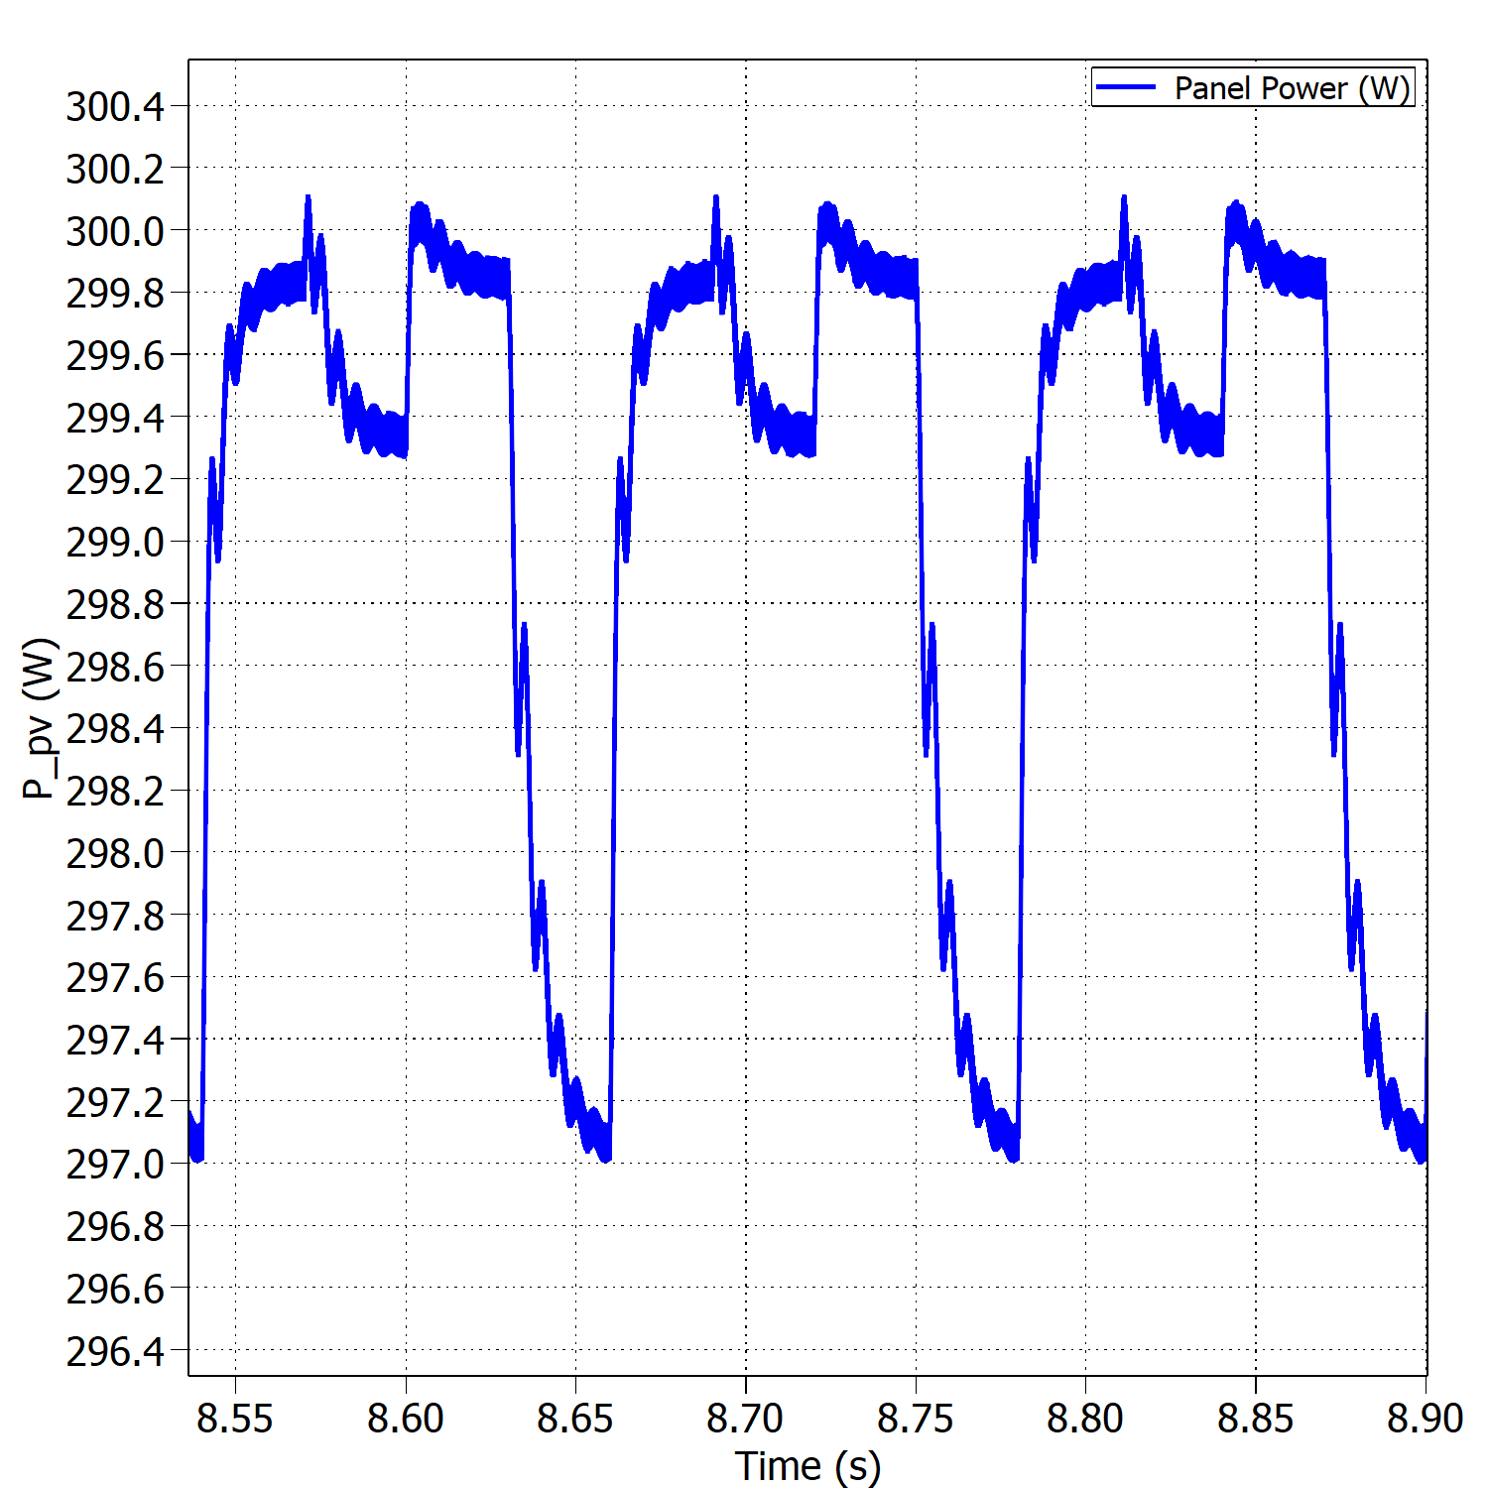
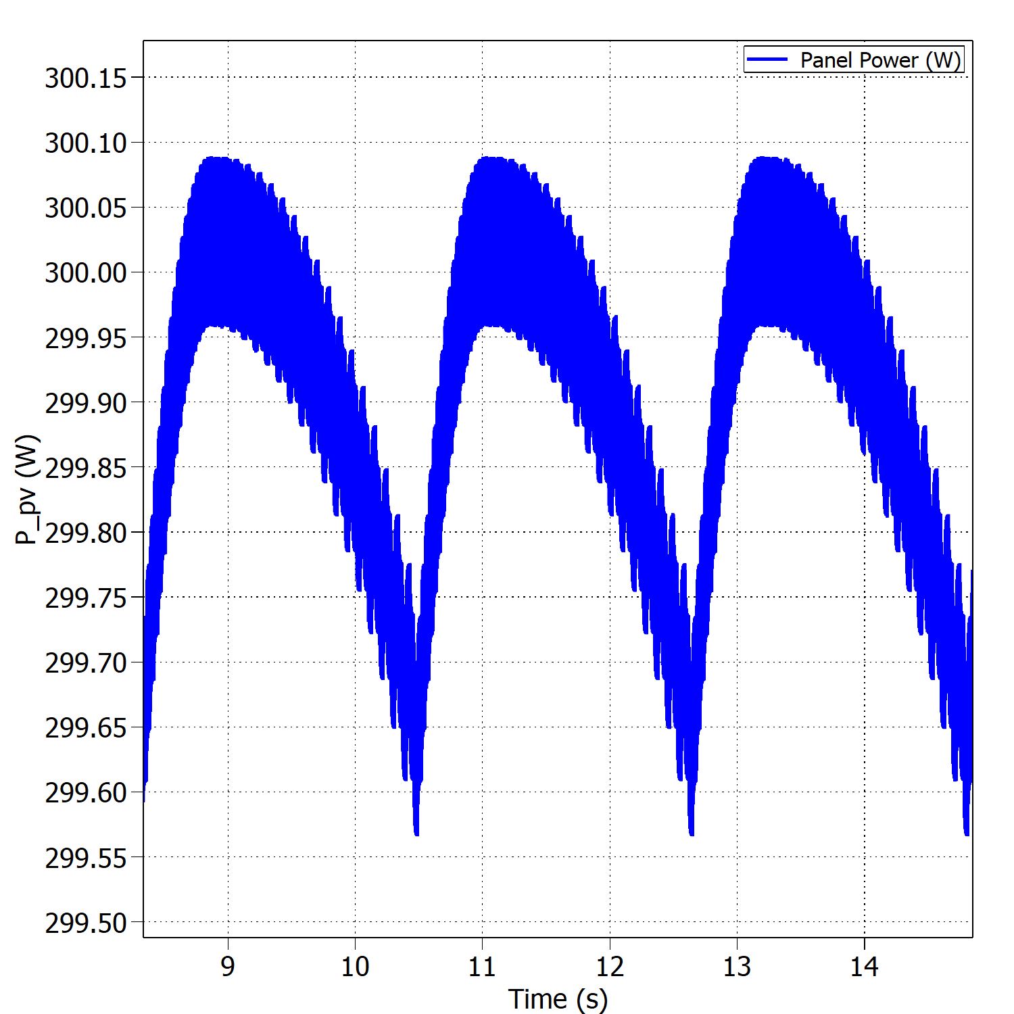


Fixed vs variable perturb step – Buck Mode
Oscillations around the MPP with fixed perturb step under STC.
Oscillations around the MPP with variable perturb step under STC.
$$η_{MPPT}=99.38\%$$
$$η_{MPPT}=99.96\%$$

Slide 12
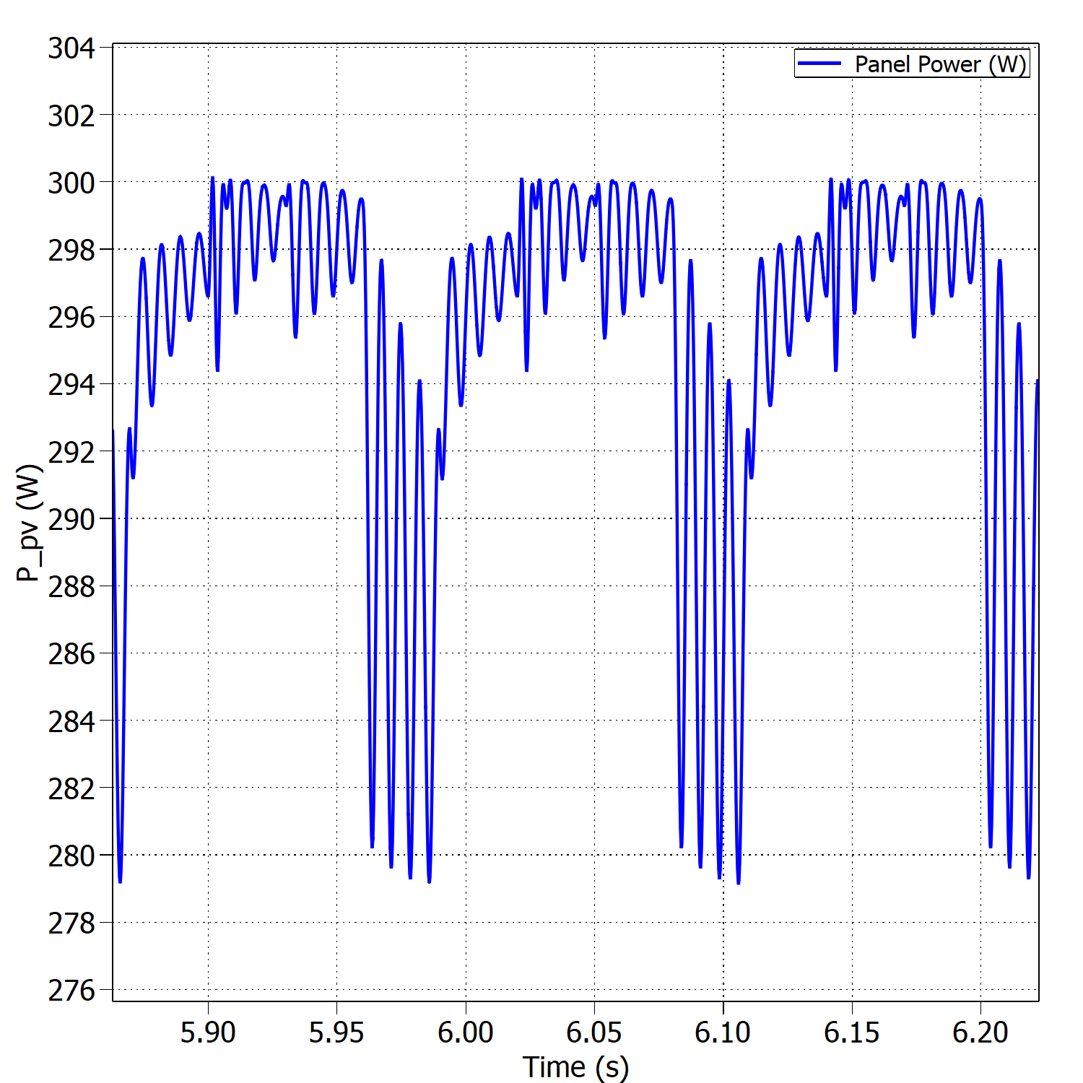
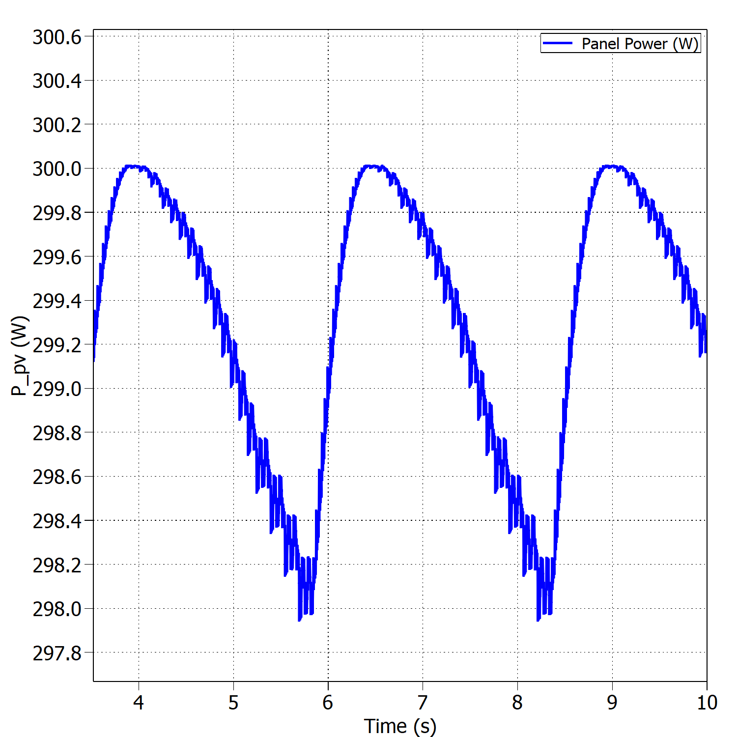


Fixed vs variable perturb step – Boost Mode
Oscillations around the MPP with fixed perturb step under STC.
Oscillations around the MPP with variable perturb step under STC.
$$η_{MPPT}=96.40\%$$
$$η_{MPPT}=99.82\%$$

Slide 13
Test Results

Slide 14
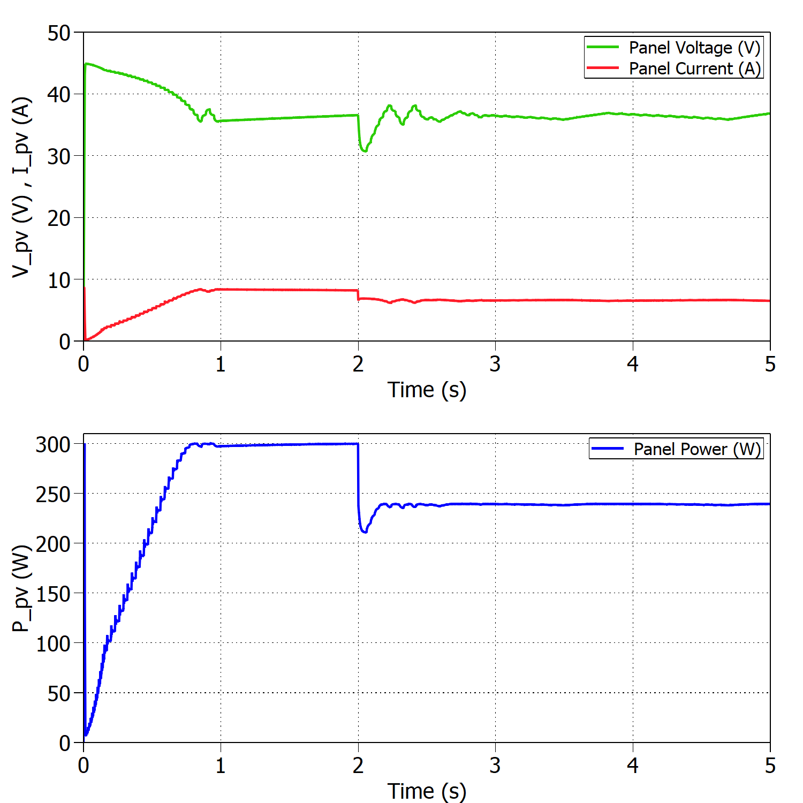
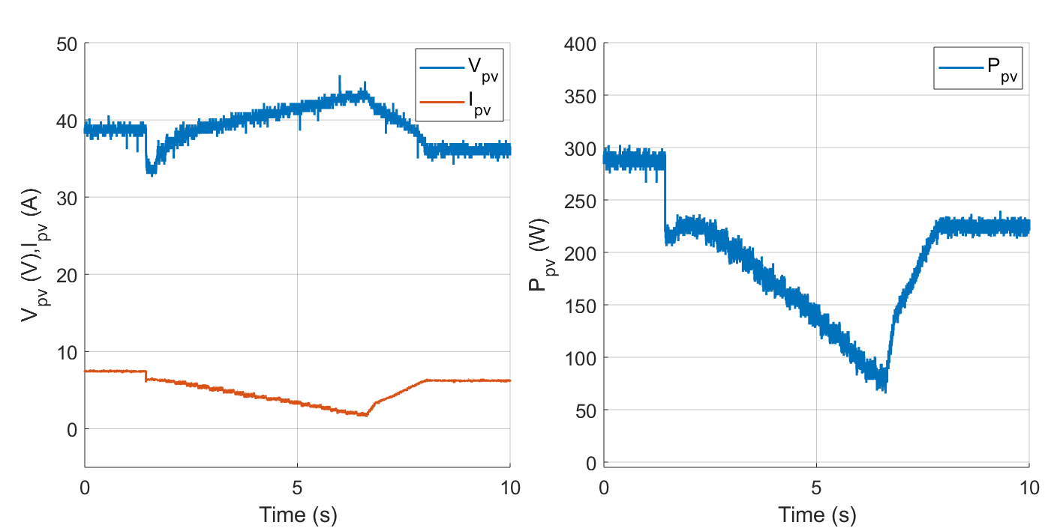
Sudden change in irradiance- Buck Mode
Experimental results for 1000 - 800 W/m2 and constant temperature T=25ºC.
Simulated results for 1000 - 800 W/m2 and constant temperature T=25ºC.

Slide 15
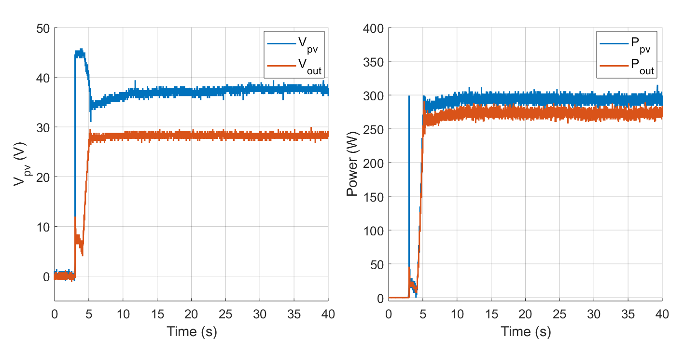

Efficiency of the converter
Voltages and powers at the converter’s input and output in Buck mode under STC.
$$η_{converter}=\frac{P_{out}}{P_{PV}} ∗100=93.15\%$$

Slide 16
Discussion

Slide 17
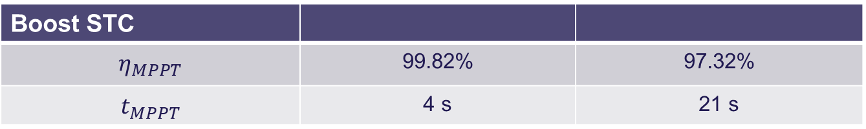
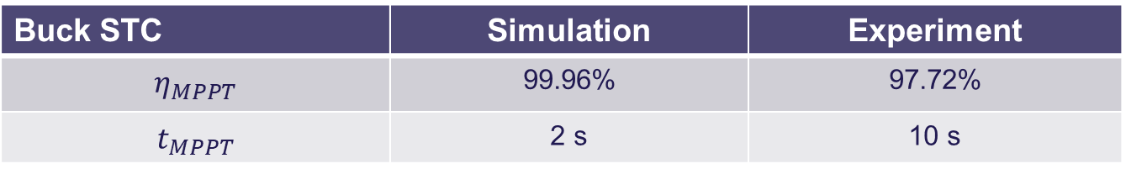
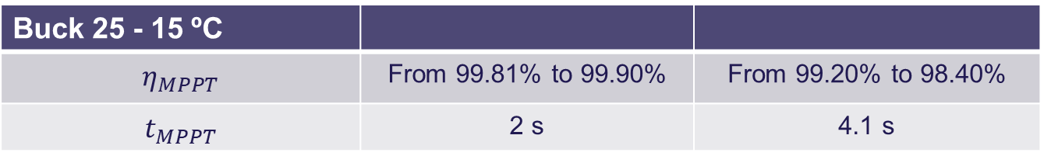

Comparison simulation and experiments
Buck STC | Simulation | Experiment
$$η_{MPPT}$$ | 99.96% | 97.72%
$$t_{MPPT}$$ | 2 s | 10 s
Boost STC
$$η_{MPPT}$$ | 99.82% | 97.32%
$$t_{MPPT}$$ | 4 s | 21 s
Buck 1000 - 800 W/m2
$$η_{MPPT}$$ | From 99.81% to 99.70% | From 95.96% to 93.78%
$$t_{MPPT}$$ | 0.5 s | 6.6 s
Buck 25 - 15 ºC
$$η_{MPPT}$$ | From 99.81% to 99.90% | From 99.20% to 98.40%
$$t_{MPPT}$$ | 2 s | 4.1 s

Slide 18
Converter design, change random picture

Slide 19

Thank you for your attention
Questions?

